Slide 1
Abstract
Primary eye care providers refer glaucoma patients
Aspecialized clinical interpretation is required to synthesize this complementary information.
Interventions for further improving detection, diagnosis, and risk stratification at the primary care level can safeguard against delayed referral to a glaucoma specialist.
In a user study with 87 optometrists, human-AI teams achieved higher accuracy (60%) than humans alone (51%), but explanations did not enhance performance.
This finding challenges the assumption that explanations alongside AI suggestions will improve clinicians’ performance, as observed in previous healthcare AI evaluations27, and underscores the challenges of designing explanations for AI support under knowledge imbalance.

Slide 2

Demand for eye care is expected to outpace the ophthalmology

Slide 3
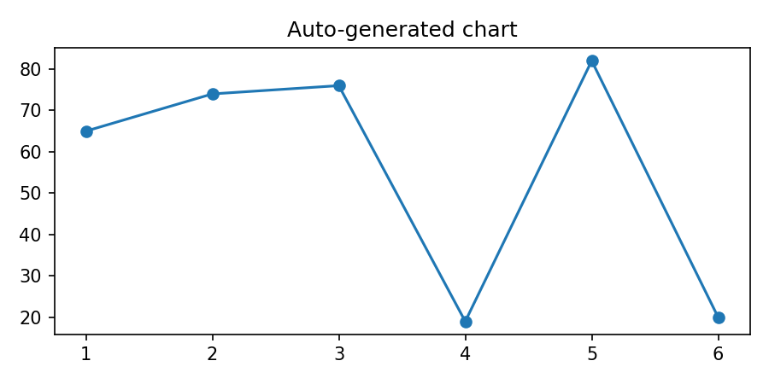
Figure 1 shows the different types of AI support for referra
Auto-generated chart

Slide 4
Closing the performance gap between the human and AI, for ex
Closing the performance gap between the human and AI, for example, involving glaucoma specialists, may help achieve synergy in referral decisions, where the combined performance exceeds that of either the human or AI alone31.
An important consideration is that users with different levels of expertise may benefit from other types of AI support better aligned with their roles, such as treatment planning or diagnostic guidance.
Despite improved team performance, there were no significant differences across AI support types, suggesting no evidence for hypothesis H1b.
We did not assess optometrists’ baseline knowledge of glaucoma, which could have influenced their performance and their ability to detect AI errors.
Moreover, it is unclear whether these results would replicate with other screening groups, such as non-specialist ophthalmologists.
Further validation with larger samples is needed to address these limitations and to overcome the restricted number of stimuli, which restricts the ability to account for algorithmic failure modes and reflect referrals across a wider range of cases.

Slide 5
Studies have demonstrated improved diagnostic accuracy with
Studies have demonstrated improved diagnostic accuracy with AI-enabled decision support35, with less experienced clinicians benefiting most from AI interventions19,36.
H1.b: AI explanations improve performance compared to groups using AI support without explanations.
Despite mixed findings about the benefit of XAI to maximize decision accuracy37,38,39, presenting explanations can enhance diagnostic accuracy21.
This improvement is anticipated under knowledge imbalance, as explanations may help users integrate AI insights with their general knowledge.
H2.a: AI support enhances decision-making experience compared to groups without AI support.
Positive impressions toward integrating AI support for breast cancer screening suggest AI improves the decision-making experience35.
Understanding benefits of AI support over humans working independently is crucial for its integration into clinical workflows.
H2.b: AI explanations enhance the decision-making experience compared to AI support without explanations.

Slide 6

We recorded whether participants completed post-graduate opt

